Slide 1
Order Processing System
Team Boolean Autocrats

Slide 2
Team members:
Anand panchal Rashmi Satwal
Anupam Kumar Thakur Ankit Vats
Harshil patil
Navya
Parul Hardikar
Astha
Radhika Mandhanya

Slide 3
Application Features
1.Security
a.Unauthorized users don’t have to access the system.
2.Logging
a.All unhandled exceptions are logged
3.Transactions

Slide 4
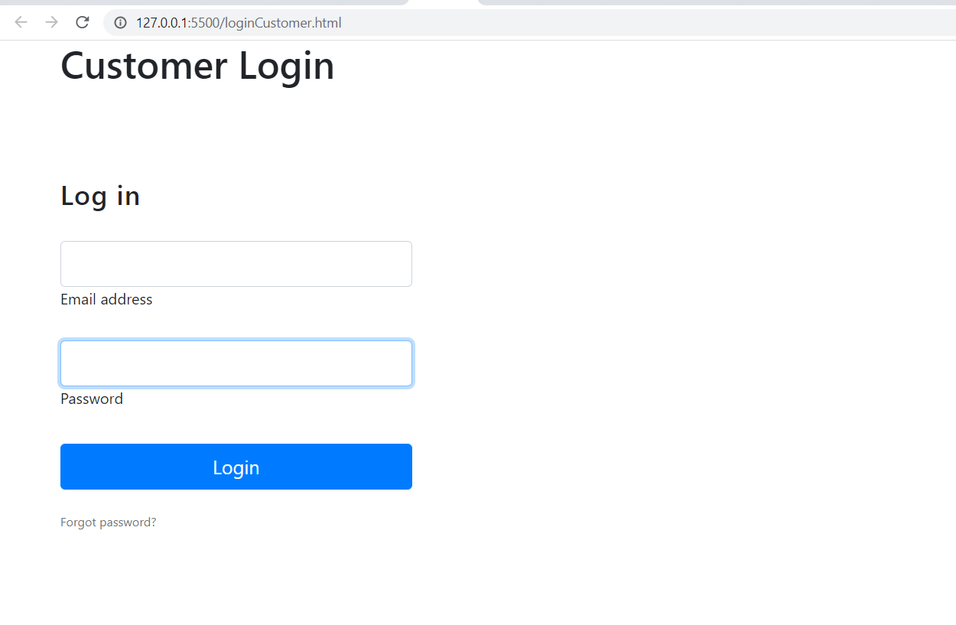
UI
Customer Login Page

Slide 5
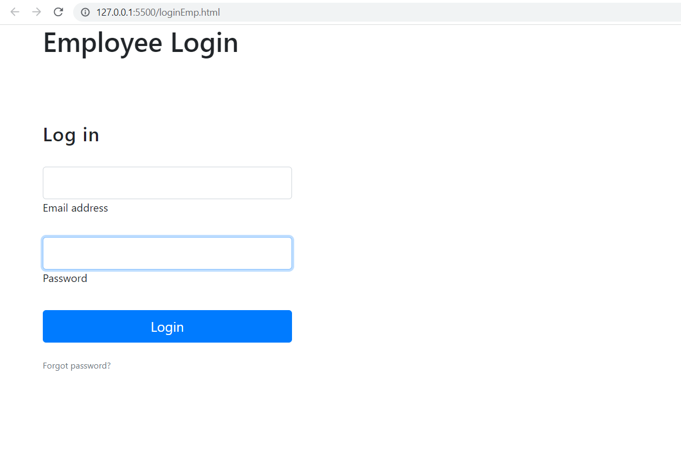
Employee Login

Slide 6
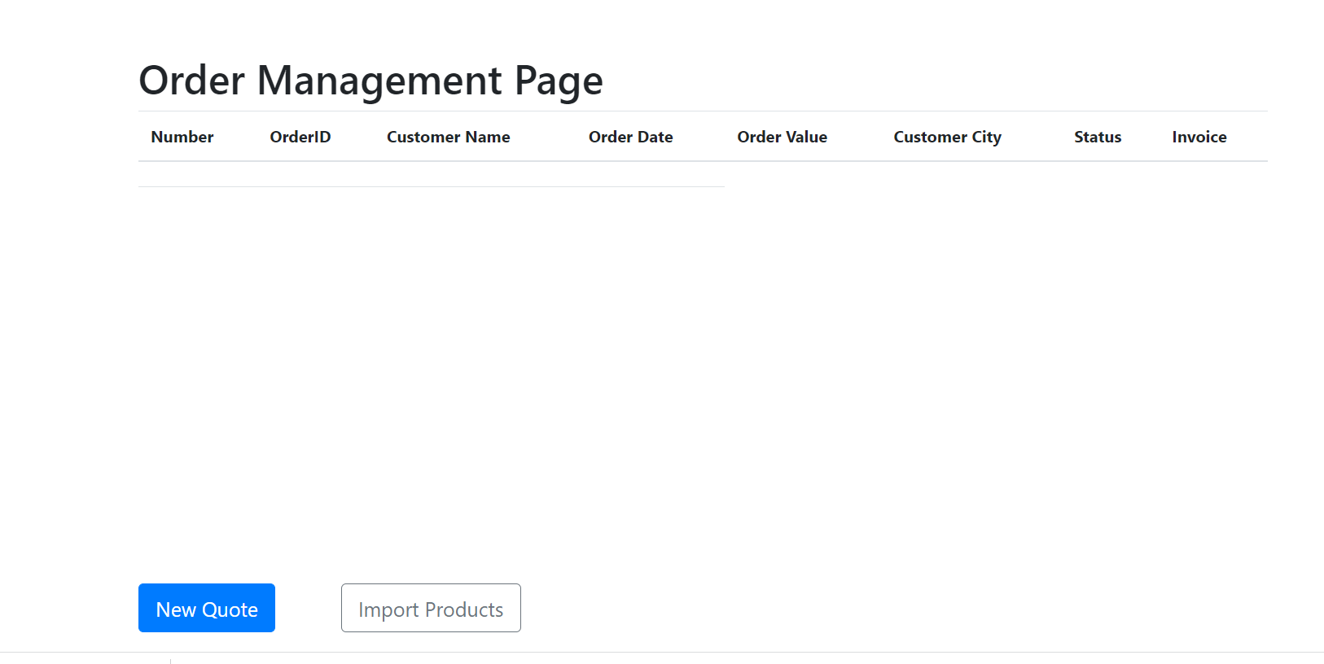
Order Management System

Slide 7
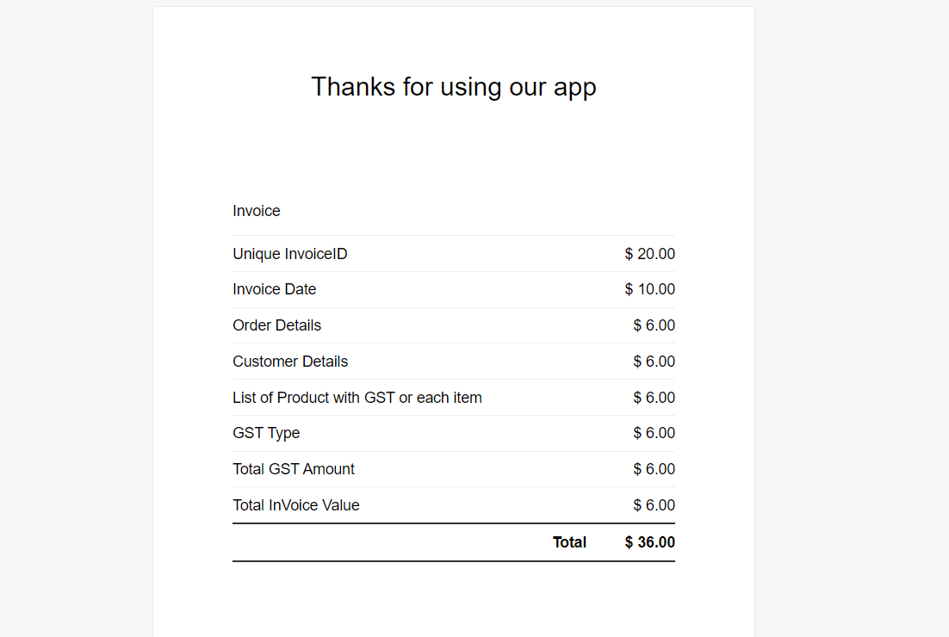
Invoice

Slide 8
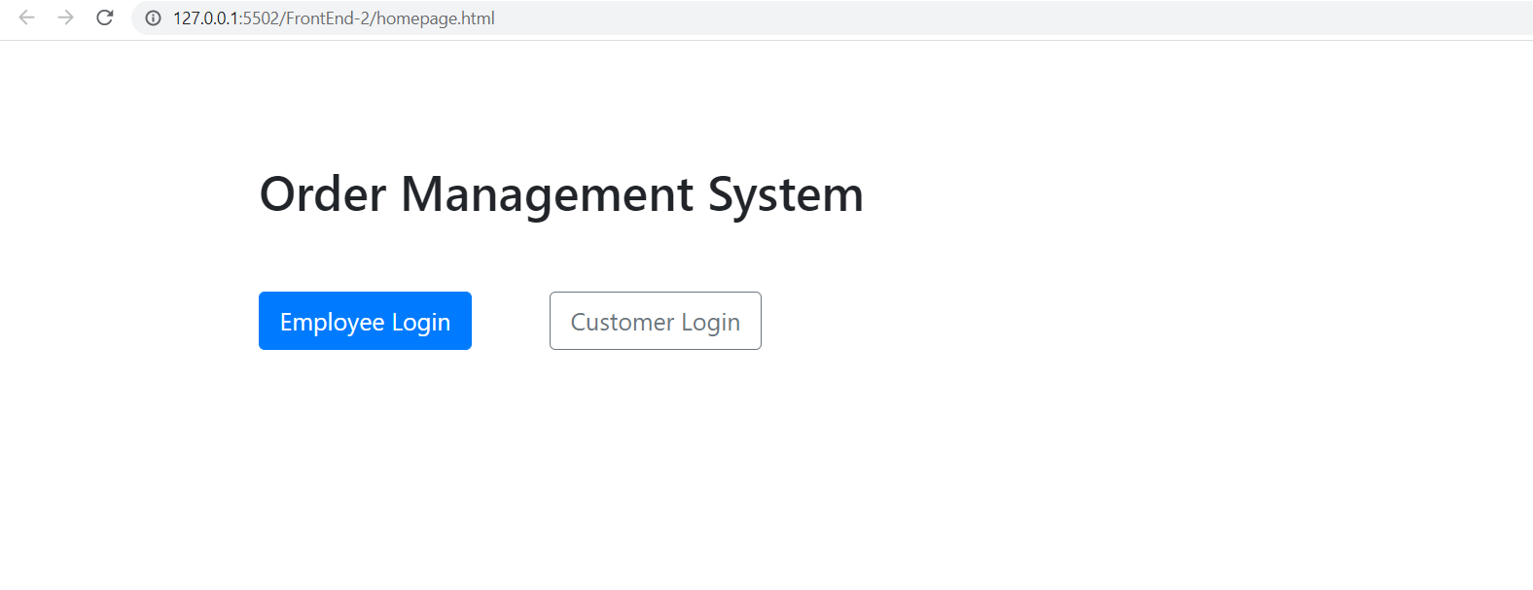
Home Page

Slide 9
Learnings:
Java,Html,Css,Javascript,Sql
Team Work
Layered Architecture
How to apply fundamentals
Network Building
Problem Solving Skills

